Slide 1
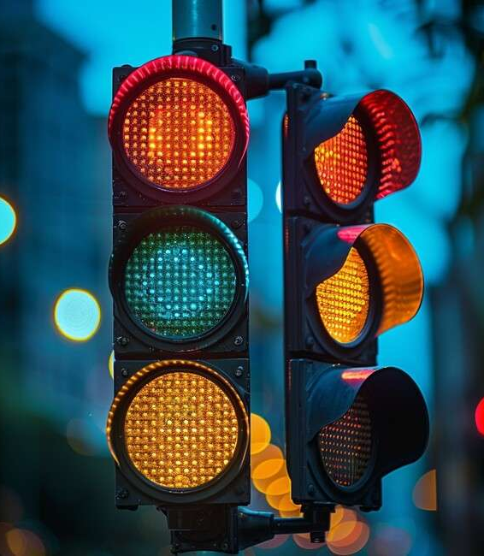
Four Lane Traffic Lights Using 555 Timer
Name | ID
Anik Deb Biswas | 23-53889-3
Tasnima Abedin Diya | 23-53890-3
Maria Rahman Trisha | 23-53886-3
Raisa Tasrin Ridi | 23-53888-3
Niharika Ibrahim | 23-50785-1
Naimul Hassan | 23-54173-3

Slide 2
Table of Content
Introduction
Theory
Apparatus
Junctions
Simulation
Procedure
Hardware Implementation
Limitation
Discussion

Slide 3

Introduction
Traffic signals control the flow of vehicles and people on the roads. They keep cars and pedestrians moving safely and help avoid accidents at busy intersections. Traffic lights are important because they make sure everyone takes turns and follows the rules, which makes the roads safer and smoother for everyone.

Slide 4
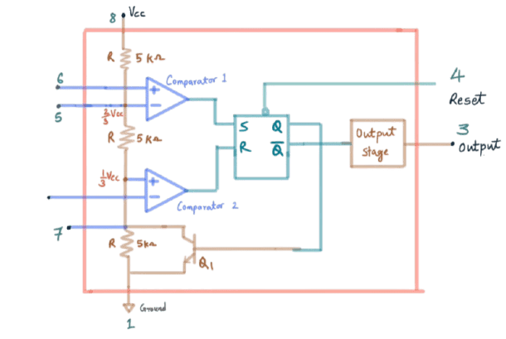
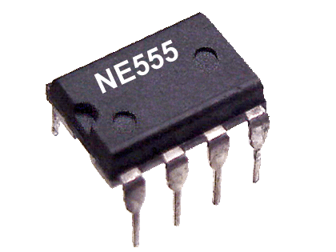
Theory
The 555 Timer IC
The 555 Timer is a versatile integrated circuit that can function as a timer, pulse generator, or oscillator. It is widely used in electronics projects to generate precise time delays or oscillating signals. In this project, it’s used in astable mode to produce continuous square wave pulses, which act as the clock signals for the 4017 decade counter.

Slide 5
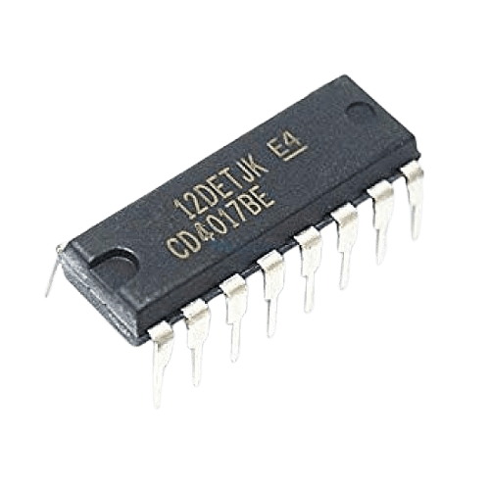
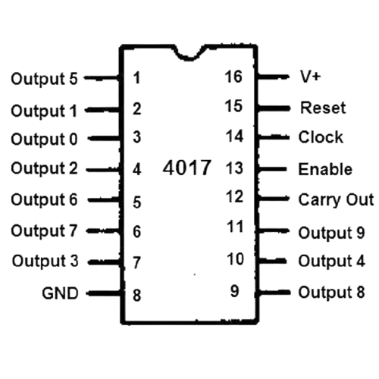
Theory
CD4017 Decade Counter
The CD4017 decade counter is a digital IC that counts from 0 to 9 in sequence with each clock pulse, activating one of its 10 outputs (Q0–Q9) one at a time while the others remain low. It has a reset pin to set the count back to zero and a clock enable pin to control counting. With each rising edge of the clock input, the active output moves to the next pin in sequence, and once it reaches Q9, it goes back to Q0 to repeat the cycle, also providing a carry-out signal for every 10th clock pulse.

Slide 6
Apparatus
EQUIPMENT NAME | QUANTITY
555 Timer IC | 1x1
CD4017 BP Decade Counter | 1x1
Capacitor 10uF | 1x1
Resistor 1kohm | 1x1
Variable Resistor 50kohm | 1x1
Resistor 220ohm | 1x3
1N4148 Diode | 1x8
LED (green) | 1x4
LED (red) | 1x4
LED (yellow) | 1x4
Battery 12V | 1x1

Slide 7

Procedure
To do the experiment, first connect a power supply and set up a Timer in astable mode using a resistor, a potentiometer, and a capacitor. Connect its output to a counter through another resistor. Power the counter and connect the appropriate pins to ground. Link the outputs to LEDs using diodes and resistors. Group the LEDs into four lanes with red, yellow, and green in each. Turn on the circuit to see the LEDs blink like traffic lights. You can adjust the timing with the potentiometer or reset it using a button.

Slide 8
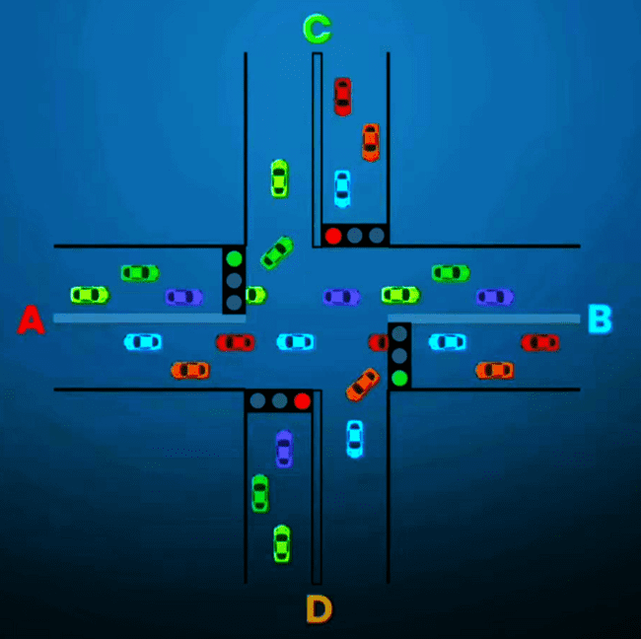
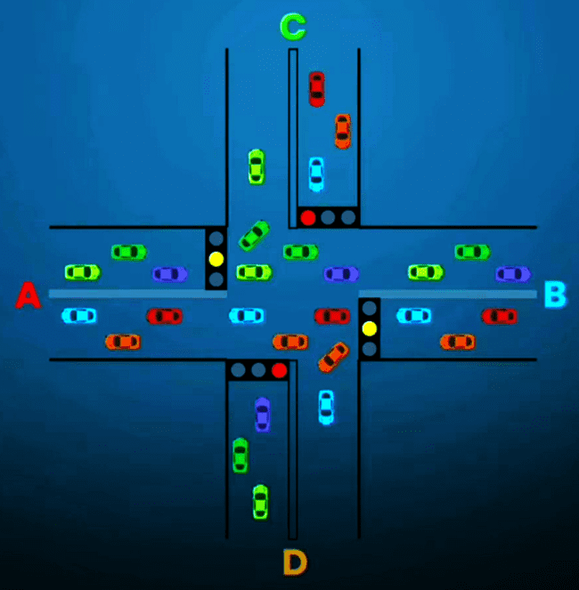
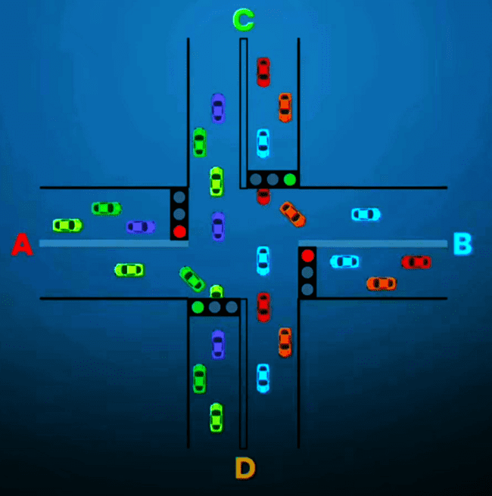
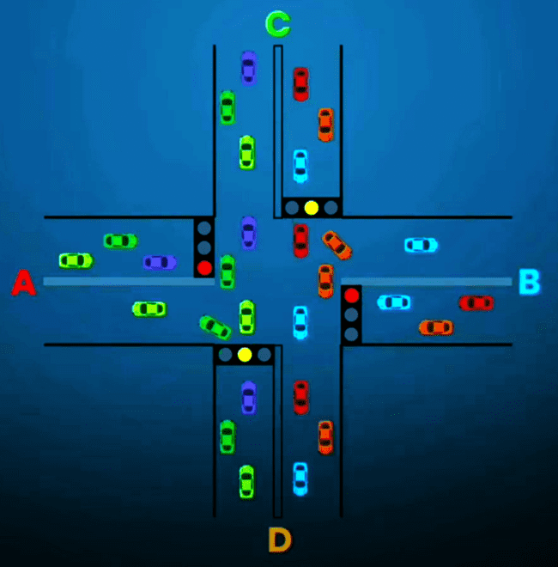
Junction
Step 1
Step 2
Step 3
Step 4

Slide 9
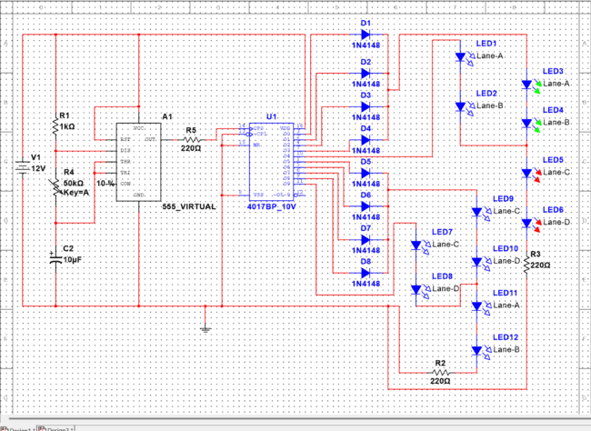
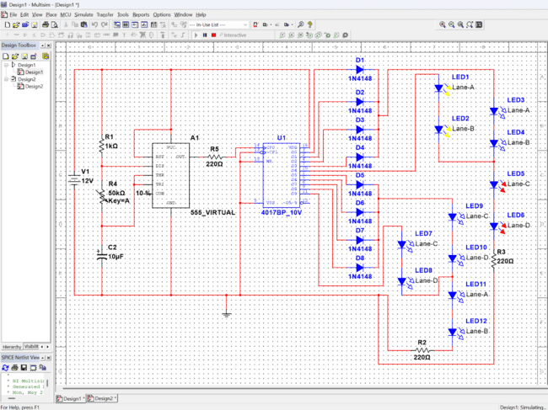
Simulation
Step 1
Step 2

Slide 10
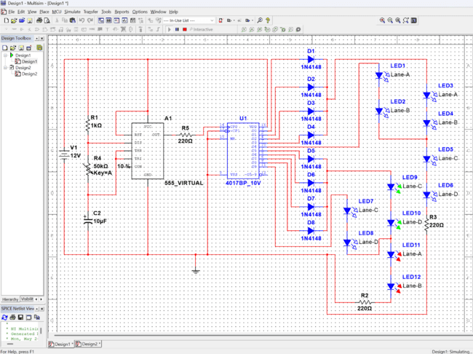
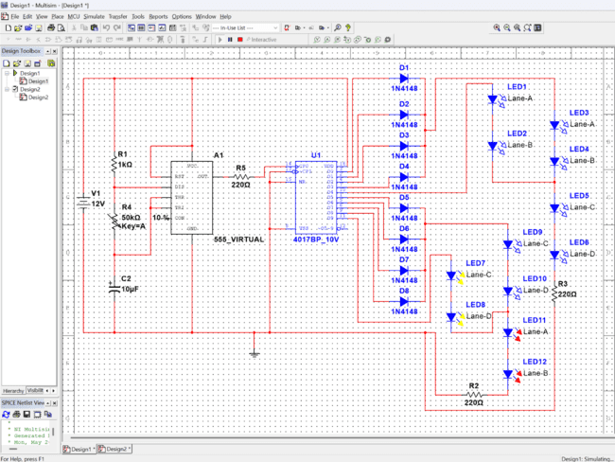
Simulation
Step 3
Step 4

Slide 11
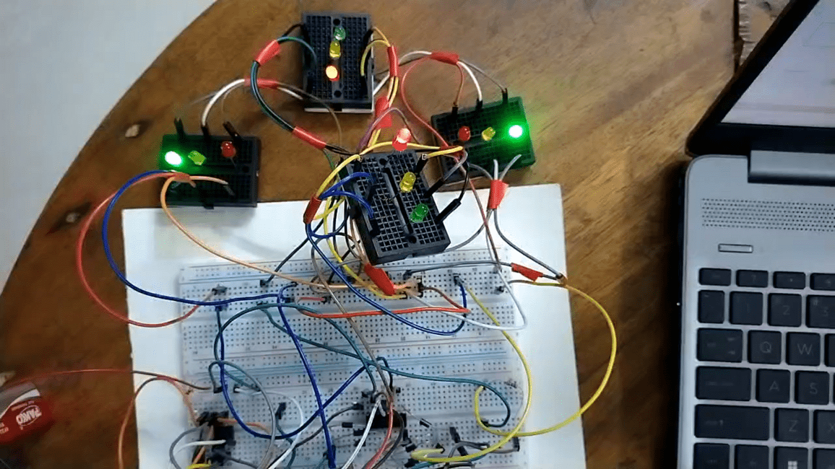
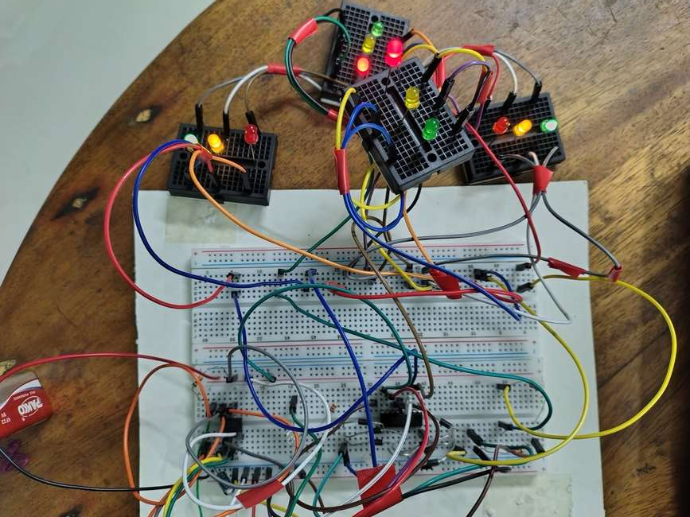
Hardware Implementation

Slide 12


Limitations

Slide 13


Discussion
This system uses a 555 timer and a CD4017 counter to simulate traffic light behavior with smooth LED transitions. The CD4017’s outputs simplify LED control, and timing can be adjusted by changing the resistor and capacitor values. It’s purely hardware-based, making it ideal for learning about counters, pulses, and sequencing. However, the fixed timing doesn’t support real-time sensing, and the CD4017’s limited outputs may need expansion for more complex traffic systems.

Slide 14

Extra Note :
Not just for traffic lights! This simple system can works on
power light shows,
step sequencers, and even
DIY smart projects.
Smart idea, small budget — big possibilities! 💡
📞 Contact :
Visit: www.yourProject.com 📞 +8801710271190 📍 Dhaka, Bangladesh

Slide 15



Thank you!!

